Slide 1
IsoMatch InDemo
Sales & Marketing Information, SMI-01-22-M
September 2022

Slide 2
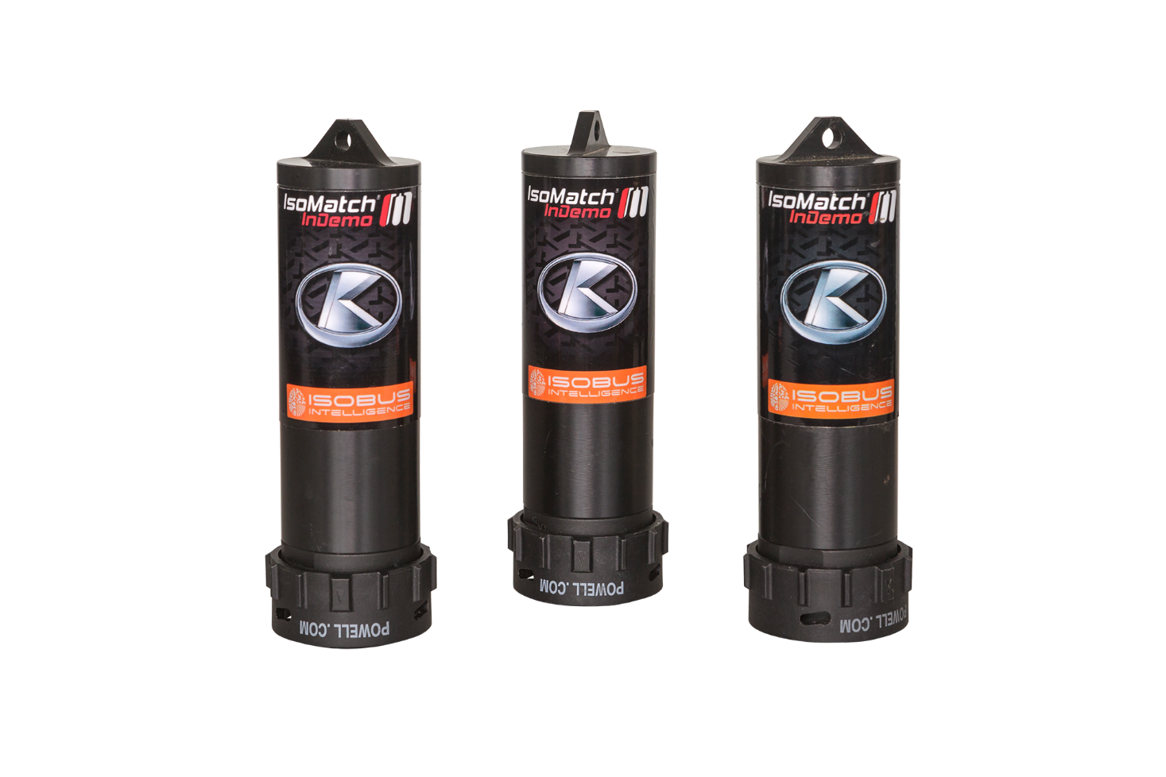
IsoMatch InDemo
With more and more implements being available in an ISOBUS version, the amount of IsoMatch InDemo’s with dedicated implement software has exploded. For Kverneland and Kubota together we have had almost 40 different types in the portfolio. This has become undoable to maintain and update, where some of the them were only sold in single units.
To make this a workable situation again Kverneland Group Mechatronics has decided to stop with the delivery of pre-flashed IsoMatch InDemo’s. We only will sell non-flashed InDemo’s which can be programmed with the desired implement software by the dealer or service technician with the IsoMatch/Kubota TopService tool.

Slide 3
IsoMatch InDemo
For Kubota these are the available IsoMatch InDemo’s per September 1st 2022:
A136216200 IM InDemo A-type KUB
A136216300 IM InDemo B-type KUB
A136216400 IM InDemo C-type KUB
A136216500 IM InDemo D-type KUB

Slide 4
IsoMatch InDemo
Following Kubota flashed InDemo’s cannot be ordered anymore at regular order desk:
A136033100 | Type A | IM InDemo butterfly (NG) KUB
A136033200 | Type A | IM InDemo e-drive (NG) KUB
A136217000 | Type A | IM InDemo e-drive micro KUB
A136216800 | Type A | IM InDemo e-com double KUB
A136215600 | Type A | IM InDemo e-com SD KUB
A136032700 | Type A | IM InDemo 4 rot/15m rake KUB
A136033300 | Type B | IM InDemo sprayer front t. KUB
A136033400 | Type B | IM InDemo weighing spread. KUB
A136215700 | Type D | IM InDemo FastBale KUB
A136216900 | Type D | IM InDemo e-com single KUB
A136153800 | Type D | IM InDemo IsoBaler SGE KUB
A136183000 | Type D | IM InDemo iXspray KUB
A136186200 | Type D | IM InDemo 4 rot/12.5m rake KUB
A136216700 | Type D | IM InDemo GEOSPREAD KUB

Slide 5
IsoMatch InDemo
In the exceptional case a customer cannot program the desired implement software himself because he does not have the IsoMatch/Kubota TopService tool, there is the option to order the InDemo inclusive implement software from our technical support team.
Procedure:
  Send your purchase order send to our Knowledge&Service Centre colleagues at mechatronicstechnicalsupport@kvernelandgroup.com
  Indicate in your order:
    Article number of which type of plug you need to have flashed KUB A/B/C/D
    What implement software has to be flashed
  A fixed additional fee for flashing software will apply on top of regular purchase price

Slide 6



Marketing material
You can find a lot of different marketing material on the Download Centre. By clicking on the icons below, the hyperlink with that specific material will open.
Brochures
Photography
Entire Package
Updated brochures and 1-pager
Different images to use online or offline
Click on this image to download the entire marketing material package

Slide 7
Contact us
P.O.’s and information requests regarding delivery lead times can be sent per email to:
customercare.mechatronics@kvernelandgroup.com
For more information please contact:
Xavier Tros de Ilarduya, Senior Product Manager Ruud Zwirs, Product Manager
xavier.tros@kvernelandgroup.com ruud.zwirs@kvernelandgroup.com
+34 6 0966 7498 +31 6 1023 4961
Gijsbert Heemink, Product Manager Maria Vasbotten, Marketing Coordinator
gijsbert.heemink@kvernelandgroup.com maria.vasbotten@kvernelandgroup.com
+31 6 2563 9336 +31 6 8270 4175
Ariadna Tost, Product Manager
ariadna.tost@kvernelandgroup.com
+34 6 8869 6667
Kverneland Group Mechatronics BV - Nieuw-Vennep - The Netherlands

Slide 8
Sales & Marketing Information, SMI-01-22-M

